Slide 1
NoSQL Metadata Management Strategies
Dan McCreary
DAMA November 2015

Slide 2
Outline
Part 1 : What is Metadata?
Diversity
Semantics
Agility
Part 2: What is a metadata registry?
The metadata registry
Search
Data governance and stewardship
Part 3: Picking the right database architectures
Why document and graph stores are ideal
Rapid data ingestion and query
Strategies for getting started

Slide 3
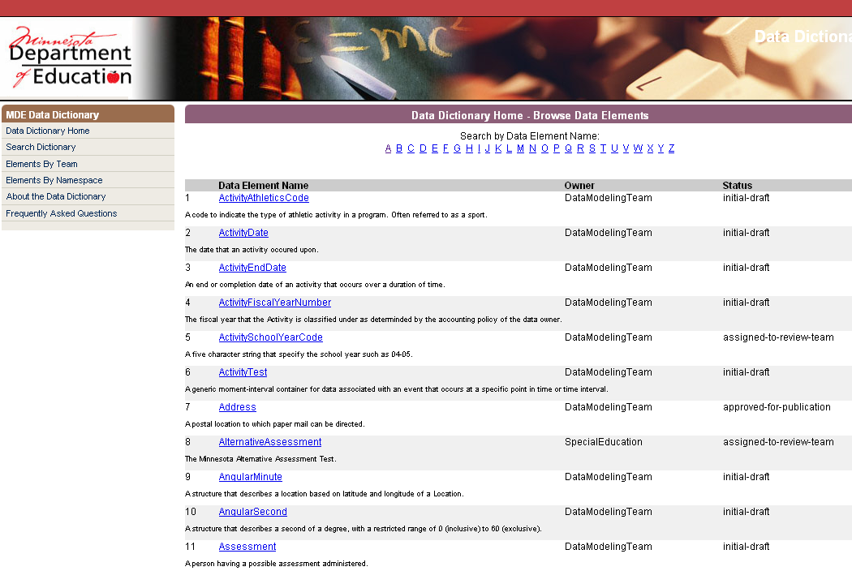
Origins: The Humble Data Dictionary

Slide 4
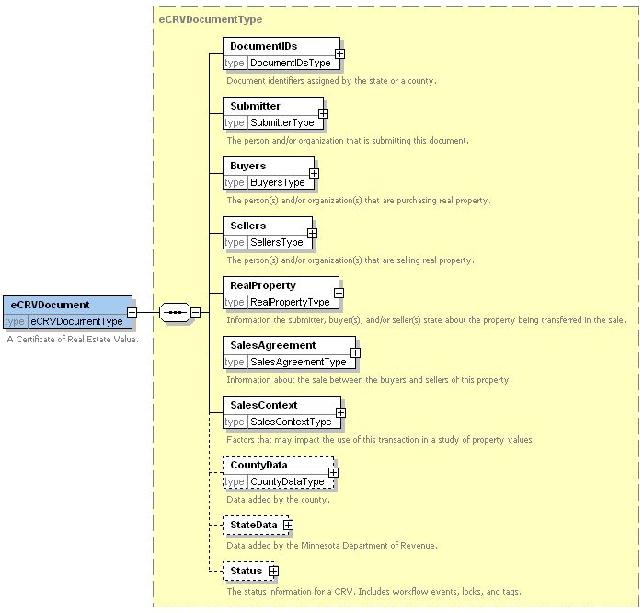
Electronic Certificate of Real Estate
Summer 2006
1 Document
= 44 SQL inserts

Slide 5
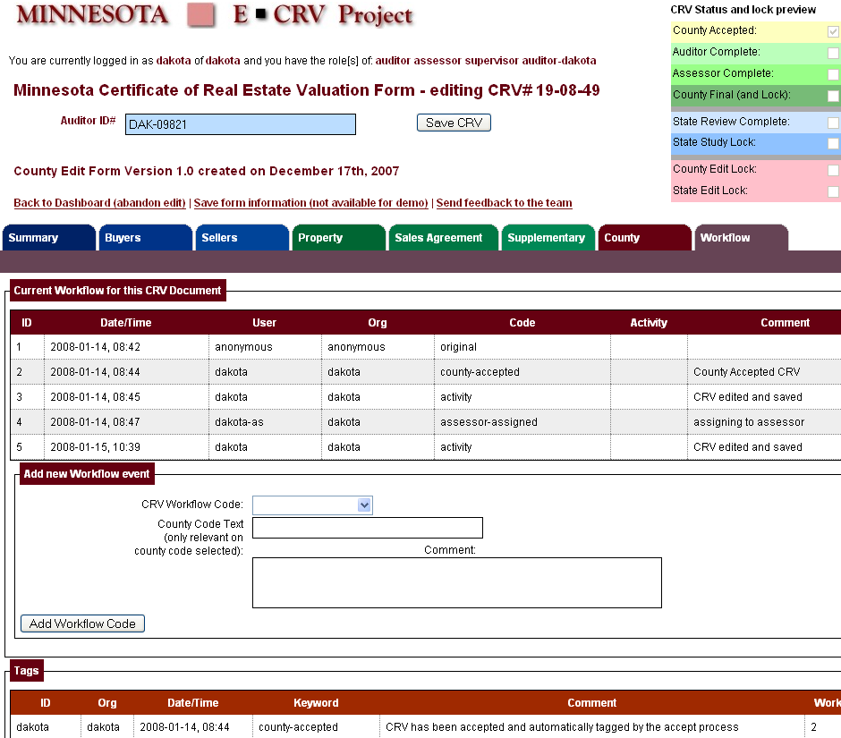
Easy to convert an XML Schema to a form
XForms
Mockup

Slide 6

Kurt's Suggestion
Use a
A Native XML
Database!
Web Form
Save
Web Browser
Kurt Cagle
store($collection, $file-name, $data)
NoSQL Database

Slide 7

Zero Translation
XForms
Web Browser
XML database
XML lives in the web browser (XForms)
REST interfaces
XML in the database (Native XML, XQuery)
XRX Web Application Architecture
No translation!
Result -> Increased agility!

Slide 8
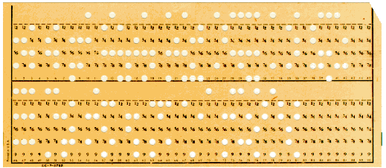
My Punchcard Epiphany
Many Processes Today Are Driven By…The constraints of yesterday…
Challenge:
Ask ourselves the question…
Do our current methods of solving problems with tabular data …
Reflect the storage of the 1950s…
Or our actual business requirements?
What database structures best solve the actual business problem?

Slide 9
Dan's 2006 Career Change
2006
1983
today
Trying put information into tables
Showing the world you don't have to put information into tables!

Slide 10
What is Metadata?
Metadata
Describes
Data
Metadata is any data that describes other data
Metadata is also data
The precise definition varies according to context
Many bar-room brawls have resulted from different definitions!

Slide 11
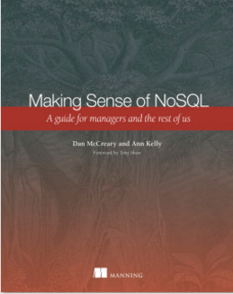
Book Metadata is a type of "descriptive metadata"
Title: Making Sense of NoSQL
Subtitle: A guide for managers and the rest of us
Authors: Daniel G. McCreary and Ann M. Kelly
Foreword: by Tony Shaw
Publisher: Manning
Publication Date: September 2013
ISBN: 9781617291074
Length: 312 pages
Print: black & white
ePub Available: yes
PDF Available: yes
Index: yes
Chapters: 12
Amazon Score: 4.7 out of 5
Table of Contents: link
Describes
Sometimes metadata describes a physical item

Slide 12
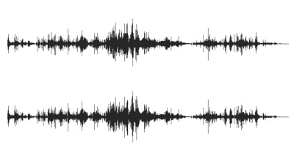
Song Metadata
<dict> <key>Track ID</key><integer>839</integer> <key>Name</key><string>Sweet Georgia Brown</string> <key>Artist</key><string>Count Basie &amp; His Orchestra</string> <key>Composer</key><string>Bernie/Pinkard/Casey</string> <key>Album</key><string>Prime Time</string> <key>Genre</key><string>Jazz</string> <key>Kind</key><string>Protected AAC audio file</string> <key>Size</key><integer>3771502</integer> <key>Total Time</key><integer>219173</integer> <key>Disc Number</key><integer>1</integer> <key>Disc Count</key><integer>1</integer> <key>Track Number</key><integer>3</integer> <key>Track Count</key><integer>8</integer> <key>Year</key><integer>1977</integer> <key>Date Modified</key><date>2004-06-16T18:10:55Z</date> <key>Date Added</key><date>2004-06-16T18:08:31Z</date> <key>Bit Rate</key><integer>128</integer> <key>Sample Rate</key><integer>44100</integer> <key>Play Count</key><integer>3</integer> <key>Play Date</key><integer>-1119376103</integer> <key>Play Date UTC</key><date>2004-08-17T16:39:53Z</date> <key>Rating</key><integer>100</integer> <key>Artwork Count</key><integer>1</integer> </dict>
Describes
XML Example from Apple iTunes

Slide 13
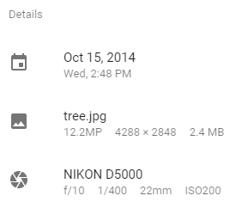
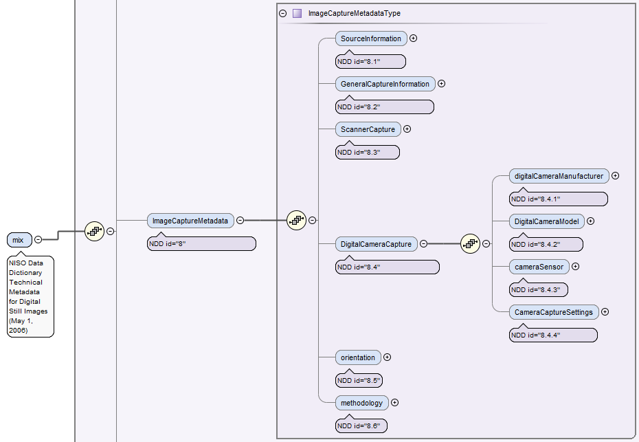

Photo Meta Data
NISO MIX digital image metadata
Metadata
Describes
Photos
Schemas
Describe
Data
http://www.loc.gov/standards/mix/mix.xsd

Slide 14
Relational Database Metadata
Person ID | First Name | Last Name | Phone | E-Mail
p12345 | Sue | Johnson | (612) 555-1234 | sue@example.com
p12222 | Doug | Anderson | (651) 555-1234 | doug@example.com
p12333 | Arun | Gupta | (763) 123-5555 | arun@example.com
p12444 | Sally | Solutions | (952) 567-8912 | sally@example.com
Metadata
Data

Slide 15
Exercise 1: What is Metadata?
Work in teams of 2 or 3 people
Write down as many types of metadata you can think of
There are no wrong answers…

Slide 16
Exercise 2: Write down everything you would like to know about a column in your database
Think about every question you have ever asked about a data element…
Think about metadata lifecycles

Slide 17
Typical Information about a RDBMS Column
Basics
Datatype
Definition
Historical
Who created this column?
When was it created?
Who wrote the definition?
Who approved the definition?
When was the definition approved?
Relationship Metadata
What other tables use this same column name?
What other tables have a column with a similar definition but use a different

Slide 18
Data Element Rule Metadata
Validity
Is the element required?
If it is numeric, what is the min and max value for the element to be valid?
If it is character data, what are the valid characters?
What other structures must be defined for this to be valid?
What are the referential integrity rules?
Are there regular expression patterns I can use to validate this field?
Statistics
What is the min, max, average and sum of this element?
Is this a candidate for an OLAP cube measurement or category?
How frequently does this data vary from a standard value?
What does a distribution chart of values look like?

Slide 19
Reference Metadata
Very often over 1/2 the tables in a Relational database holds "reference data"
Tables that help us convert numeric codes into English labels
Example:
Customer Database at local Healthcare Company had over 250 tables
Over 200 tables were just reference data
Organizations purchase Reference Data Management (RDM) solutions for over six figures

Slide 20
Social Metadata
What requirement drove the creation of this element?
Is the definition clear?
precise, concise, distinct, non-circular, unencumbered with rules?
Does everyone in our organization agree on the definition?
do different business units have an alternate "label" for this element?
What reports use this data element?
How do the reports format the element?
Is the data element converted to other forms/units?
How often do we export this element?

Slide 21
Security Metadata
Does this data element identify a person?
Would it be considered either of the following?
Protected Healthcare Information (PHI)
Personally Identifiable Information (PII)
What roles can see this data?
Should the data be encrypted on-disk?
http://csrc.nist.gov/publications/nistpubs/800-122/sp800-122.pdf
https://www.hipaa.com/hipaa-protected-health-information-what-does-phi-include/

Slide 22
QA Attributes
What unit and system tests do we have for the values?
How can we verify that the values are consistent with other fields
think US Postal service address standardization
How would we create a quality score (1 to 100) for this data element?

Slide 23
Semantic Metadata
What is the role of a data steward in this element?
What data governance processes did we use?
How does this data element relate to other data exchange standards?
Semantic equivalency ("same as" relationships)
Semantic mapping
Data conversion

Slide 24
Summary
Metadata is really complex
Metadata has many forms (not a flat list of attributes)
Different users and different teams have different needs for metadata
There is no simple standard structure for all perspectives
How do we store complex metadata?

Slide 25
Part 2: What is NoSQL?
How can we use documents and graphs to manage metadata?
What is a metadata registry?
Why "registry" and not "repository"
What do people put in a metadata registry?
Why is search so important?
How do we select the right database for our metadata registry?

Slide 26
Before NoSQL
Relational
Analytical (OLAP)
26

Slide 27
After NoSQL
Relational
Analytical (OLAP)
Key-Value
key
value
key
value
key
value
key
value
Column-Family
Graph
Document
27

Slide 28
But where should we store our metadata?
Relational
Analytical (OLAP)
Key-Value
key
value
key
value
key
value
key
value
Column-Family
Graph
Document
28

Slide 29
Answer: Graph and Document Stores
Relational
Analytical (OLAP)
Key-Value
key
value
key
value
key
value
key
value
Column-Family
Graph
Document
29

Slide 30
Three Top Reasons to Use NoSQL to Store Metadata
Agility – we can load anything in without modeling
Agility – we can quickly transform things
Agility – we can quickly create new services and views
Note: Only companies that make the transition from relational to NoSQL can benefit

Slide 31
Where does NoSQL metadata come from?
<person xmlns="http://mycompany.com/hr"> <id>12345</id> <first-name>Sue</first-name> <last-name>Johnson</last-name> <phones> <home> (952) 555-1234 </home> <work> (612) 555-1234 </work> </phones> <e-mails> <work>sue@mycompany.com</work> <personal>sue-johnson@myisp.com</personal> </e-mails> </person>
Data Governance
(namespace URI)
Metadata (Element Name)
Data (Values)

Slide 32
Compare Metadata Origin Flexibility
RDBMS
Document/Graph
Created in a Data Definition Language (DDL) using "CREATE TABLE" statements
Fixed structure per table
no per-row variability
Fixed datatype per column
Unused data must still use placeholders
New data elements can not be loaded without redefining the DDL
Ideal for homogeneous data
Created by in-line metadata
Flexible structure
allows one-to-one, one to many, many to many, all in one file
Every "item" (document or node) can be different
New data elements can always be loaded without disturbing load process
Database is "agnostic" on the structure of incoming data

Slide 33


NoSQL is "Schema Agnostic"
Systems that automatically determine how to index data as the data is loaded into the database
No a priori knowledge of data structure
No need for up-front logical data modeling
…but some modeling is still critical
Adding new data elements or changing data elements is not disruptive
Each data element can be indexed as it is encountered
Searching millions of records can still has sub-second response time
ER
Modeling

Slide 34

Four Translations
T1
T2
T4
T3
Web Browser
Object Middle
Tier
Relational
Database
T1 – HTML into Java Objects
T2 – Java Objects into SQL Tables
T3 – Tables into Objects
T4 – Objects into HTML

Slide 35
The Translation “Pain Chain”
Name:
Street:
City:
Zip:
Web Forms
Objects
RDBMS
From web forms to objects…to SQL inserts…to selects…to objects and back to web forms
Many format translations…

Slide 36

Key Question: Impact on Agility
What impact do zero translation NoSQL systems have on system agility?
Agility: the ability to quickly react to changing business requirements at any stage of the software development lifecycle
Question: Big impact or little impact?
Answer: Big impact when you have complex or highly variable data

Slide 37

The Heart of the Enterprise
The Metadata Registry
A metadata registry is a central location in an organization where metadata definitions are stored and maintained in a controlled method.
http://en.wikipedia.org/wiki/Metadata_registry

Slide 38

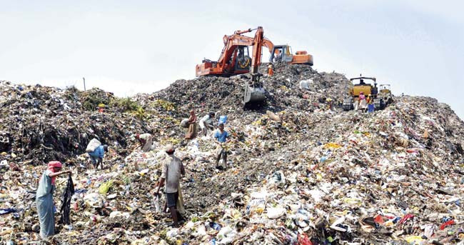
Registry vs. Repository
Registry
Repository
A curated collection of non-duplicative data elements
A searchable single point of truth
Curate: to select, organize, and look after the items in a collection
A dumping ground for things that can possibly be shared
No focus on removing duplicates
No focus on search

Slide 39
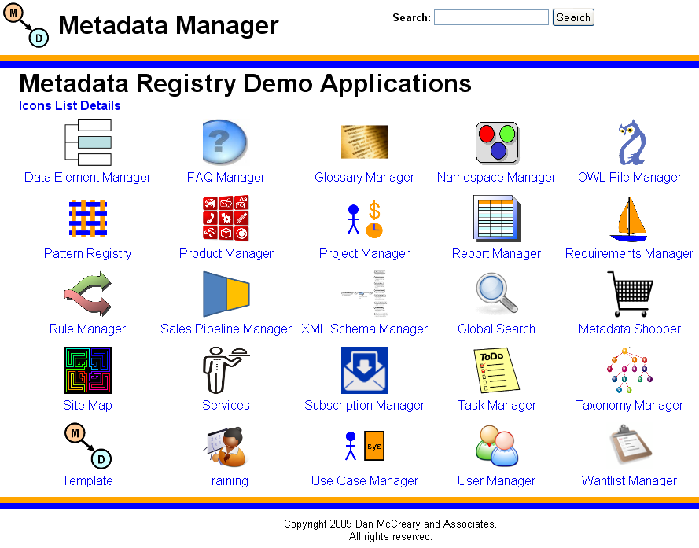
Metadata Manager

Slide 40
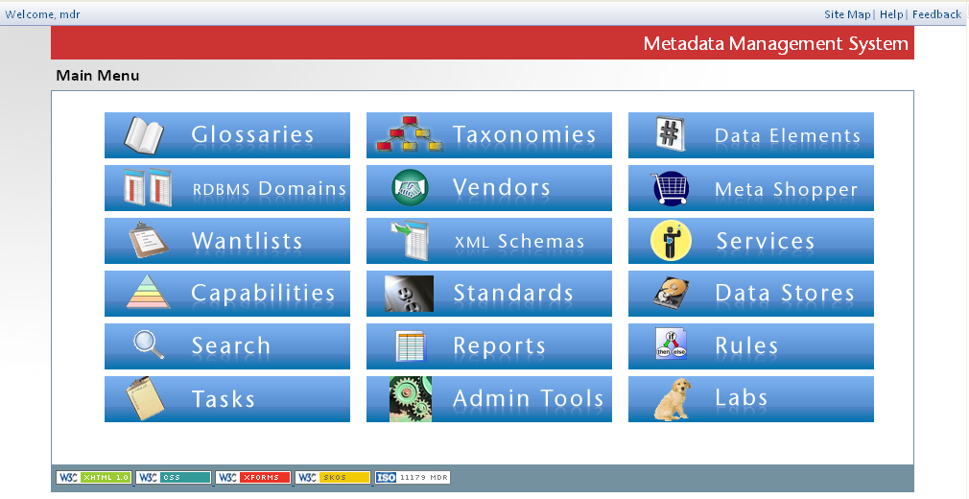
Twin Cities Financial Institution

Slide 41
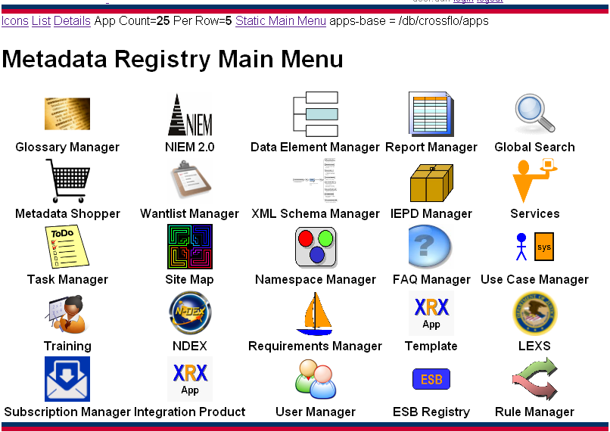
Federal Integrator

Slide 42
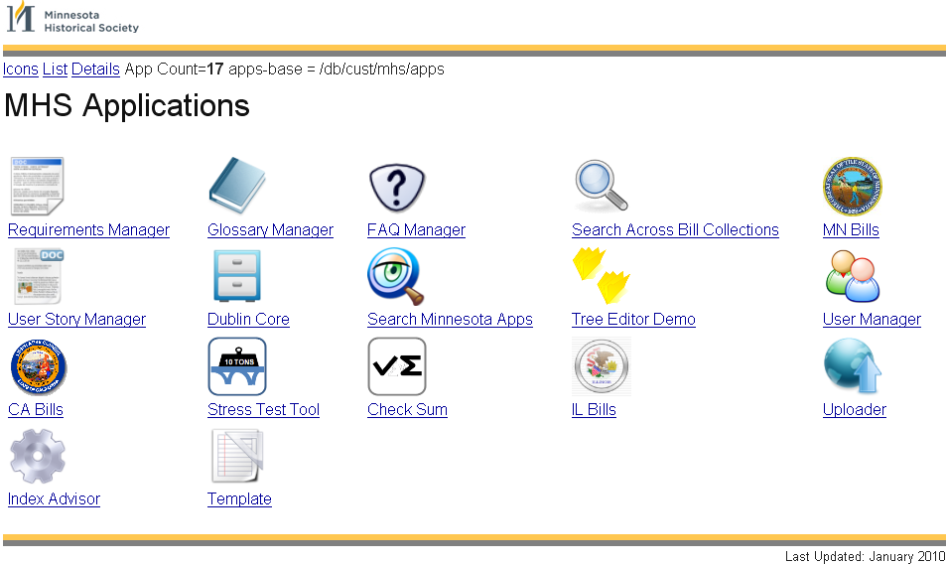
Minnesota Historical Society

Slide 43
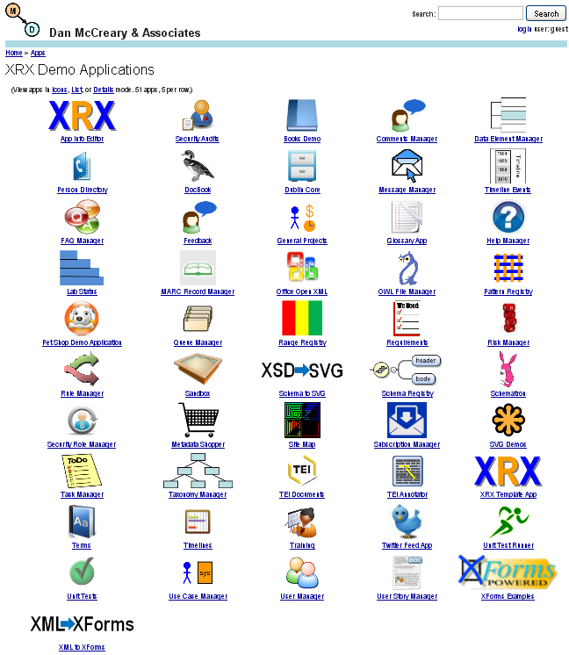
XRX Apps Demo Site
Demo site for danmccreary.com
Some programs written under an hour with student data
Several utility programs that start with template and add transformations to other formats
Focus on metadata management

Slide 44
Managed Metadata
The processes surrounding the creation and management of enterprise metadata and their definitions
ISO 11179: "Administered Items"
Traceability:
Who created data definitions and when and in what context for what purpose?

Slide 45
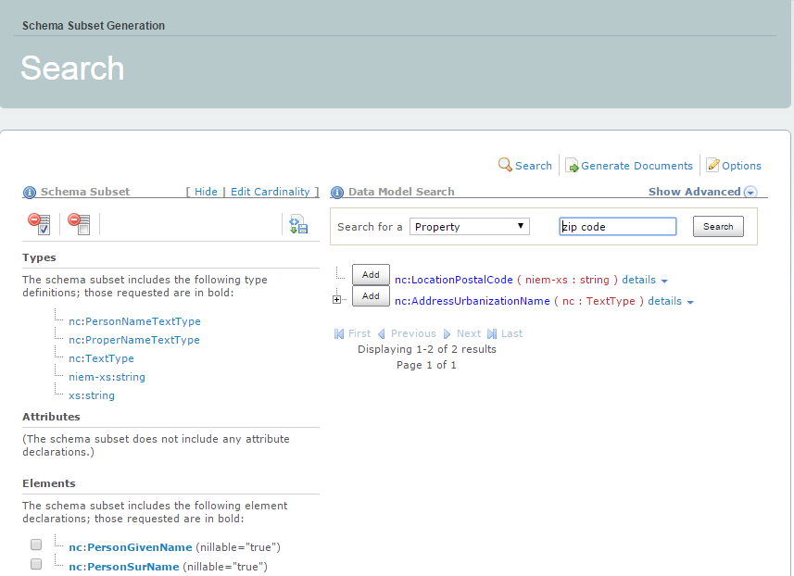
The NIEM Model
NIEM = "National Information Exchange Model"
https://tools.niem.gov/niemtools/ssgt/index.iepd

Slide 46

The Metadata Shopping Cart
Easy for anyone to go "shopping" for metadata
Search tool helps you find the data elements you need
When you are done you "save" your elements into a "wantlist"
Wantlists are used by reporting tools and data exchanges to build new artifacts
Business rules understand the needs of each data element (data type dependency)

Slide 47
Sample Data Flows
Data Element Views
Business
Terms
(SKOS)
NIEM
Data Elements
Internal
Data Elements
Customer
Data Elements
Draft
Data Elements
In Review
Data Elements
Published
Data Elements
ISO/IEC 11179
Metadata Shopper
Wantlist
subset
Constraint
Schemas
Instance
Examples
UML
Diagrams
Exchange Packages
Users/Roles
Security
Policy
47

Slide 48
EMM Requirements
EMM = Enterprise Metadata Management
Tools to create an "enterprise trust" in data element definitions (Data Governance)
Tools to eliminate duplication of data elements
Powerful search
Metadata web services
Controls who adds and updates definitions
Support for data stewardship and data governance

Slide 49
Dan's Promise to Every BA
If you are…
somewhat familiar with HTML and SQL
willing to "know your data"
willing to spend around 40 hours in training
able to use NoSQL software
Then…
Within three months you can build and maintain your own metadata registry

Slide 50

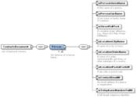
Change Where the Line is Drawn
Requirements
Requirements
SME
BAs
Developers
vs.
Graphical Requirements and Specifications
SME/BA
IT Staff
Shorten the “distance” between the business unit and the IT staff using machine-readable requirements - models

Slide 51
Semantic Triangle
concept
labels
“cat”
symbol
referent
Symbols can only link to referents through concepts
You can not link directly from a symbol to a referent
Wikipedia: Semiotic triangle

Slide 52
SKOS (Simple Knowledge Organization System)
A W3C standard for building "controlled vocabularies"
A simple flat "Glossary of Terms"
Terms with relationships (broader terms, narrower terms)
Support for a preferred label for a concept and alternate labels
A basis for building other artifacts
Taxonomies
Ontologies
Rules

Slide 53
SKOS is based on RDF standard
RDF = "Resource Description Framework"
A way of storing "facts" as a node, arc and a node
Subject
Predicate
Object

Slide 54
RDF Fundamentals
http://example.com/person/dan
http://example.com/properties/lives-in
All Subjects are URIs
All Predicates are URIs
Objects are URIs or Literal Strings
Joining two graphs together allows new inferences to be made
RDF is the basis of Linked Data
http://example.com/locations/minnneapolis

Slide 55
Automatic Document Classification
Automatic
Classification
Engine
Word
Doc
Document
Classification
Rankings
Ontology
For excellent case studies go to: http://www.smartlogic.com/industries-and-solutions
Disclaimer: My wife wrote many of these!

Slide 56
Semantic Precision in Space and Time
space: (projects, organizations)
world
Large
Semantic Footprint
(long lifetime systems)
enter- prise
dept.
team
Small Semantic Footprint
(rapid prototype)
person
time
weeks
months
years
10+ years
Notes:
Think of a semantic wave front.
If you select and existing declarative language you start out with a larger footprint.
Making an internal groups “object library” public is often not practical for security reasons.
Making data definitions is usually much more realistic.

Slide 57
Two Kinds of Thinking
"In the Can"
"On The Wire"
Screen
Enterprise Service Bus
Objects
Adapter
Adapter
Publishers
Subscribers
Database
Horizontal
Publish/Subscribe
Messages
Communication of Shared Meaning (Semantics)
Good for large organizations
Vertical
Siloed
Translation-intensive
Application-centric
Good for small teams

Slide 58

Structured Retrieval is Better
Introduction to Information Retrieval
by Christopher D. Manning, Prabhakar Raghavan and Hinrich Schütze
Cambridge University Press, 2008
http://nlp.stanford.edu/IR-book/information-retrieval-book.html

Slide 59
Table 10.1 - Revised
 | RDB search | unstructured retrieval | structured retrieval
objects | records | unstructured documents | trees with text at leaves
model | relational model | vector space & others | XML hierarchy
main data structure | table | inverted index | trees with node-ids for document ids
queries | SQL | free text queries | XQuery fulltext
XML - Table 10.1 and structured information retrieval. SQLRDB (relational database) search, unstructured information retrieval

Slide 60
Retain Document Structure in Search
"Bag of Words"
"Retained Structure"
doc-id
keywords
keywords
'love'
keywords
keywords
'hate'
keywords
'new'
'fear'
keywords
All keywords in a single container
Only count frequencies are stored with each word
Keywords associated with each sub-document component
Assign higher weight for titles and names
Set by non-programmer

Slide 61
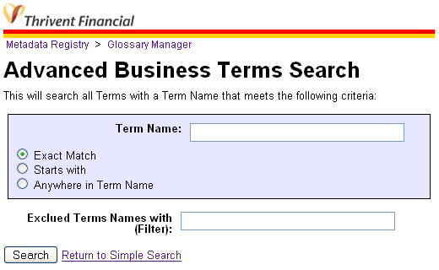
Omni and Complex Search
Exact Match
Wildcard search
Boosted rankings for each team
Starts with searches
Filters
Removed results

Slide 62
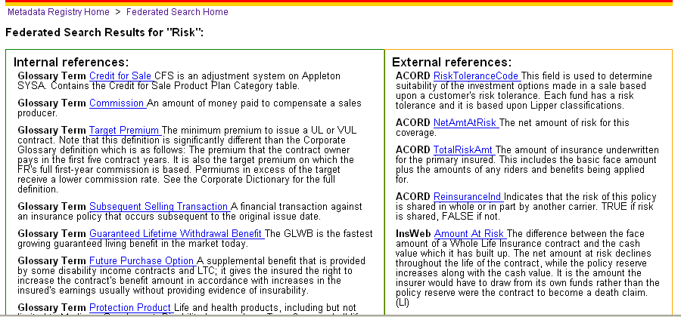
Internal vs. External Terms
Internal Data Standards
External Data Standards

Slide 63
Selecting a Database for your Metadata Registry
Can I used a relational database?
What will be the results if I go with a NoSQL database?
How do we objectively select the right database?
What process steps should we use?
What about training?

Slide 64
Relational database vendors are still offering users a 1990’s era product, using code written in the 1980’s, designed to solve the data problems of the 1970’s, with an idea that came around in the 1960’s.

Slide 65


Using the Right Architecture
Start
Finish
Find ways to remove barriers to empowering
the non programmers on your team.

Slide 66


Empower the Non Programmer!
Before NoSQL MDR
After MDR
SUPER PM, BA!
BA
Sorry, we have no idea what code 42 means.
Let me search our registry…
I'll have your answer in 150 milliseconds.

Slide 67
Six "S"s of Metadata Agility
Semantics – build around shard metadata registry services
Search – structured search
Standards – CSS, XML, XPath, XQuery, XForms, XML Schemas
Services – all XQueries are REST services
Solutions - that are quickly customized
Super – Empower the non-programmers

Slide 68
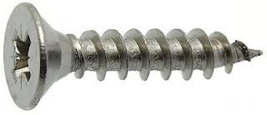


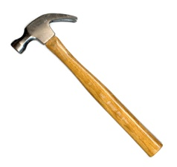


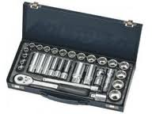
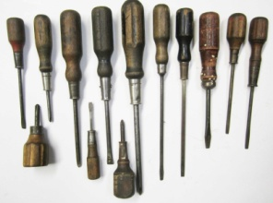
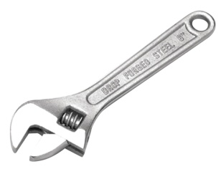
Finding the right tool for the job
The Problem:
Many possible Solutions:
What tool will have the best fit? Multiple tools? One item vs. many?

Slide 69
ATAM Process Flow
Business
Drivers
Quality
Attributes
User
Stories
Analysis
Architecture Plan
Architectural
Approaches
Architectural
Decisions
Tradeoffs
Impacts
Sensitivity
Points
Non-Risks
Distilled info
Risk Themes
Risks
This process defined by CMU's Software Engineering Institute

Slide 70
Architecture Selection
Make it easy to
use and extend
Architecture
Make it easy to
create and maintain code
Developers
Business Unit
Provide long-term competitive advantage
Architecture Selection
Team
Make it easy to
monitor and scale
Operations
Marketing
Everyone can help understand the consequence of an agile metadata management system

Slide 71
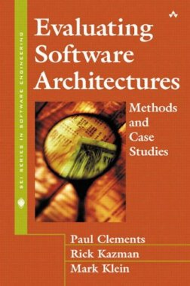
Key Book for Selection Methodology
Evaluating Software Architectures: Methods and Case Studies
by Paul Clements, Rick Kazman, and Mark Klein
Addison-Wesley, 2001
We need "Evaluating Database Architectures"!

Slide 72
Sample Utility Tree
Agile Loading
Each topic (Quality Attribute) helps focus the discussion of a selection team
The topics vary from project to project
Big Data projects focus on "Scalability" and "Findability" etc.
Objective ranking of requirements before you begin talking about architecture alternatives
Schema Agnostic
Transformability
Search
Data Quality
Document Models
Agile Services
Security
Standards Based

Slide 73
Many tools to ingest various data types (Word, Excel, XML, JSON) (Very Important)
Many Data Formats
Agile Loading
Drag and Drop Loading
We use desktop drag-and-drop tools to load data into our database (eg. WebDAV) (Important)
The system does not require us to do any up-front data modeling. (Very Important)
No Upfront Modeling
Schema Agnostic
Metadata Used
The system use inline-metadata to index all fields as soon a they are loaded (Very Important)

Slide 74
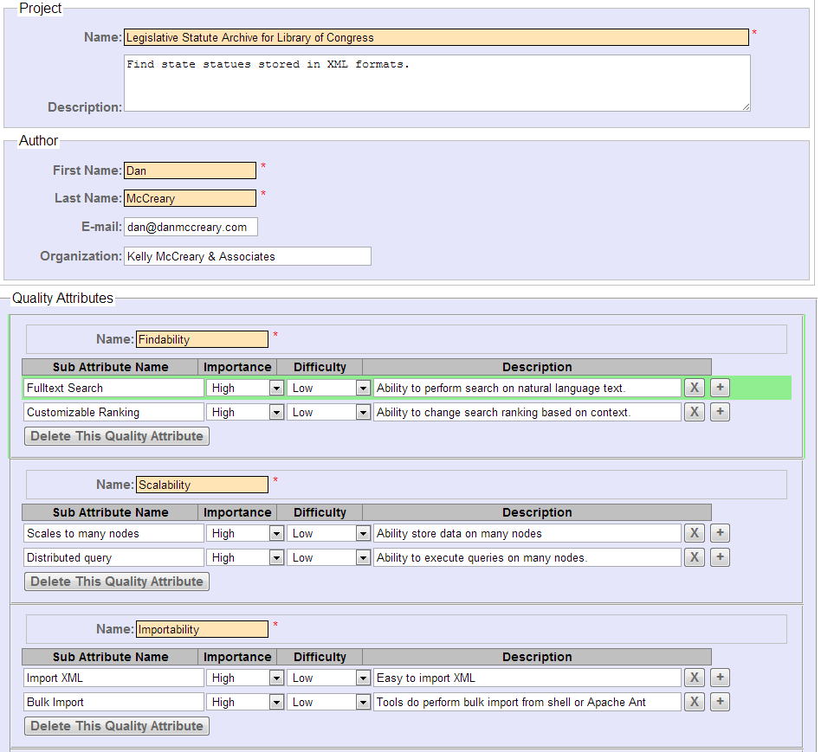
Quality Attribute Utility Tree Application

Slide 75
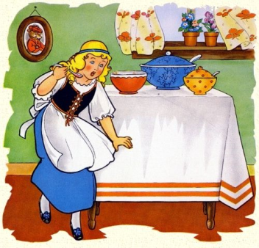
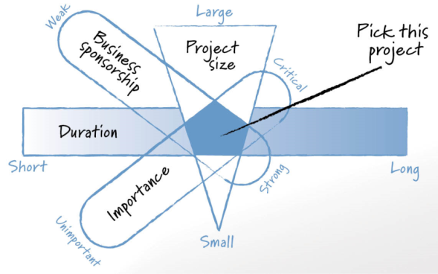
Selecting a Pilot Project
The "Goldilocks Pilot Project Strategy"
Not to big, not to small, just the right size
Duration
Sponsorship
Importance
Skills
Mentorship

Slide 76
The "J" Curve of Learning NoSQL
High
Confidence Level
Time
3 months
Low
Training and Mentoring

Slide 77
Summary
Metadata
is diverse and has many viewpoints
is about semantics
must be easily searchable
Metadata Registries
Our your single point of truth about meaning
Build trust
Must be authoritative
Accelerate development
Document and Graph Stores
Are the best place to store metadata
Are more agile then RDBMS systems
Are difficult to get started without a training and mentoring
Will provide huge long-term rewards

Slide 78
Thank You! Dan McCreary dan.mccreary@marklogic.com

